Slide 1

Insights
By: Edward Yuen, Patrick Ly

Slide 2
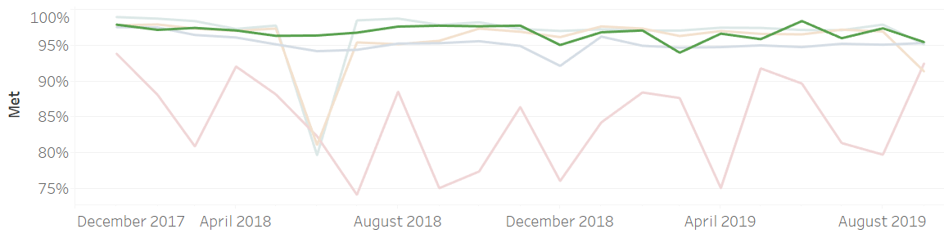
Replicate Success of Responding to Mental Health Calls
Is Response to Mental Health / Substance Abuse Calls successful?
Which need categories have opportunities to improve?
Disaster Services (7k Not Met, 7%), Individual / Family Life (2k Not Met, 7%)

Slide 3
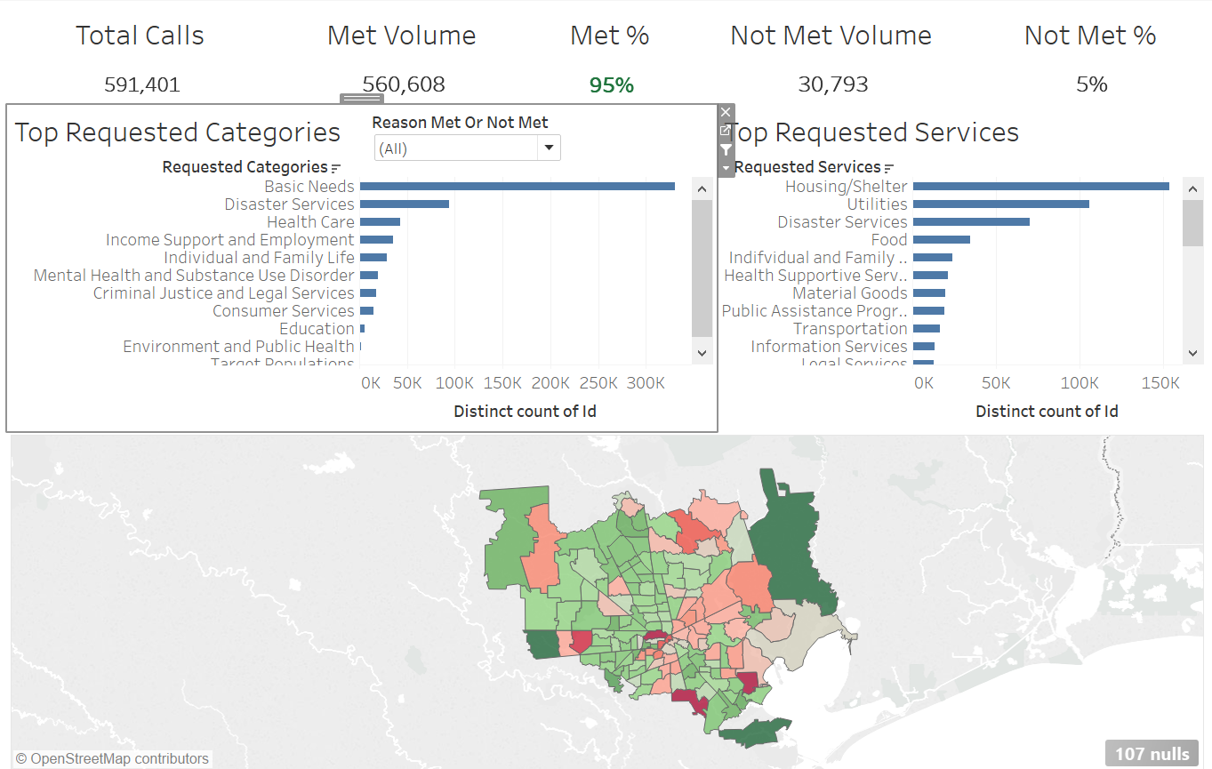
Harris Country Overview

Slide 4
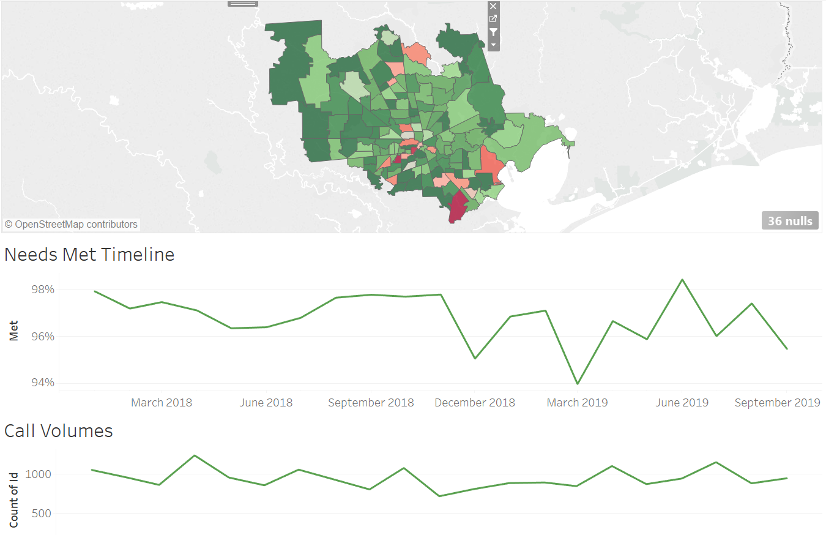
Mental Health / Substance Abuse Services

Slide 5
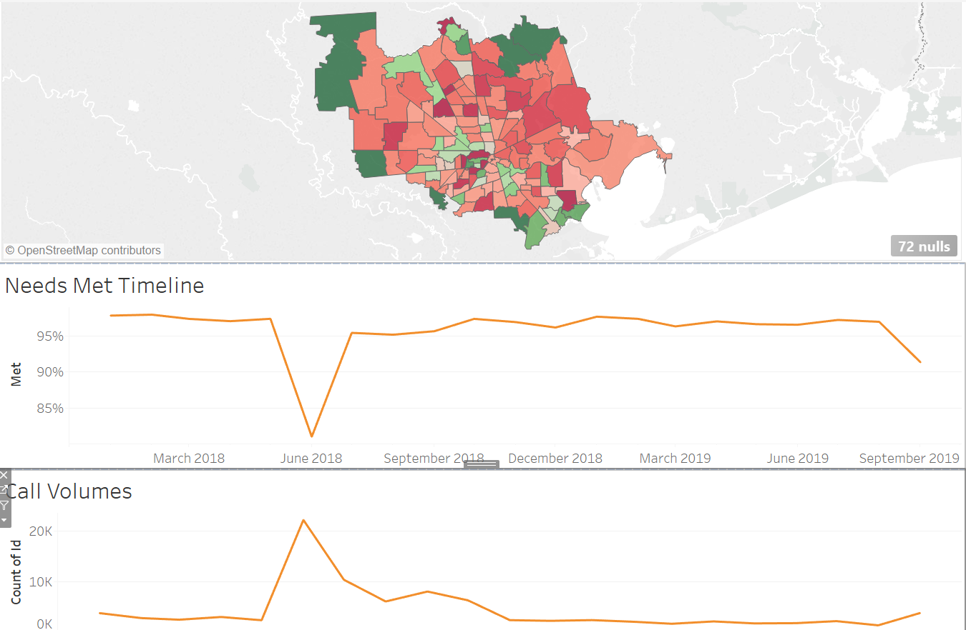
Disaster Services

Slide 6
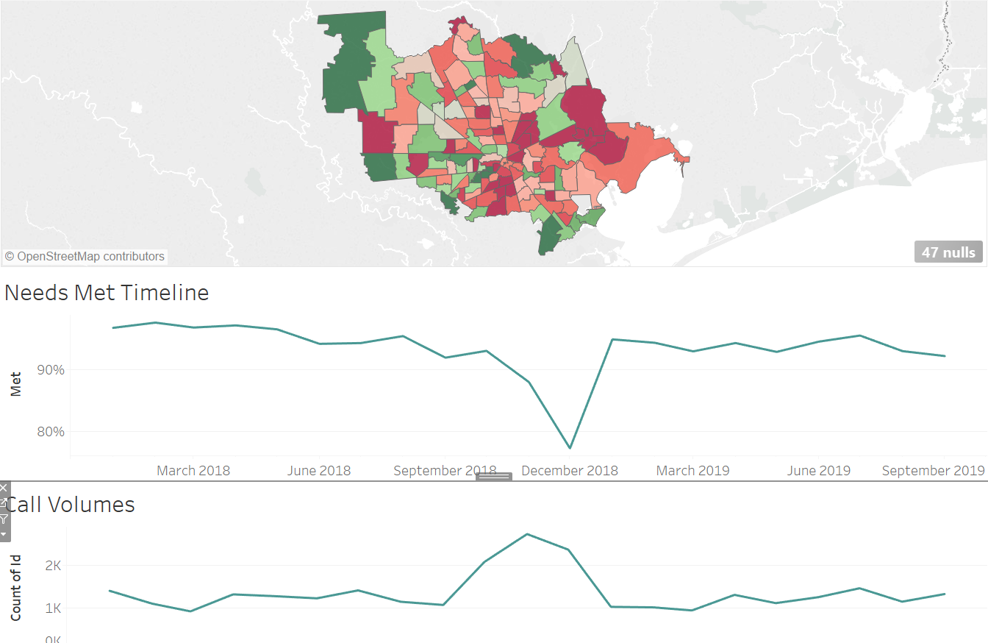
Individual / Family Life

Slide 7
Findings
Overall services met needs 95% of the time
Mental Health / Substance Abuse Services has high success
Disaster Services, Individual / Family Life Services opportunities to improve
Disaster Services impacted by June 2018 weather events
Individual / Family Life Services impacted by December 2018 (potentially holidays)

Slide 8
Next Steps
Action Items
Use dashboard to find gaps in coverage
Brainstorm solutions to address gaps
Follow Up Questions
How many agencies and programs were used for each Need Category
Locations of program agencies
Compare 2-1-1 calls to population by zip code to measure 2-1-1 outreach

